Slide 1
National Coordination Open Science - NL
Karel Luyben
Meeting Helsinki
October 21, 2019

Slide 2
WHY – WHAT - HOW
WHY
1
2
3
4
WHAT
1
2
3
4
HOW
1
2
3
4

Slide 4
National Plan Open Science
Key ambitions
Full open access to publications in 2020
To make research data optimally suited for reuse
Recognition and rewards for researchers and proposals
To promote and support Open Science optimally
Notes:
Notitie:
Continue the Dutch approach for all Dutch research organisations and research
areas whilst recognising their differences and similarities.
To set clear and agreed technical and policy-related preconditions to facilitate reuse
of research data, including provision of the necessary expertise and support.
To examine together how open science can be an element of the evaluation and
reward system for researchers, research groups and research proposals.
To establish a ‘clearing house’ for all information regarding all available research
support.

Slide 5
National Platform

Slide 6
Governance
Steering Committee (chaired by the Ministry of Education)
National coordinator
OS Platform
Theme groups
Secretariat

Slide 7
National
Coordination
structure
NPOS
Steering Group
Advisory group
secretariat
NCOS
Open Access programme
FAIR Data programme
Citizen Science programme
P₁
P₂
P₃
P₄
P₅
P₆
P₇
Open Science Community

Slide 8
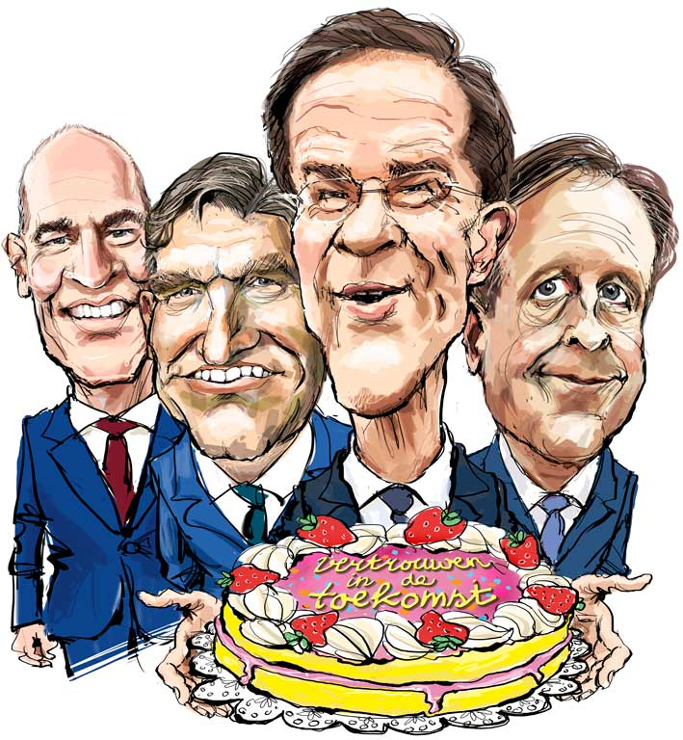
Confidence in the future of open science in the Netherlands
“Open science and open access become the norm in scientific research.”
Coalition Agreement
2017 - 2021
Notes:
Notitie: Deze sheet is een knipoog naar het regeerakkoord met betrekking tot open science. Verwijder deze sheet als het niet wil gebruiken.

Slide 9
Functional requirements for NCOS
scientist with leadership experience and involved in the international developments of open science
able to take the different needs of different disciplines into account
authority in the platform and an ‘icon’ for the (external) stakeholders
knowledge of the different themes and their relationship
able to enthuse researchers and board members for the open science development
taking responsibility for realising the open science ambitions
linking the different subsystems in the Netherlands together
actively involved in setting the national agenda on open science
knowledgeable about the (inter)national developments in open science
mandate to actively steer the four theme groups and inform the steering committee

Slide 10
Website
www.openscience.nl

